Slide 1
To Build AWS Based IoT System
By Dr. Sasirekha GVK Annapoorna G
Aakash Khot
Under Prof. Jyotsna Bapat

Slide 2
Introduction
Amazon Web Services(AWS) is a free and on-demand cloud computing platforms that helps us to build, deploy and manage websites, Apps on AWS Secure Network services supported by data centers globally.
AWS IoT Core is a managed cloud service that connects devices easily and securely interact with the cloud applications or other devices.

Slide 3
Cost Factor
AWS Free Tier is available to AWS IoT Core Customers from the day AWS account created.
Free usage Tier includes :-
2,250,000 minutes of connection.
500,000 messages.
225,000 registry or device shadow operations.
After free tier usage: Connectivity costs $0.042 per device and varies according to region.

Slide 4
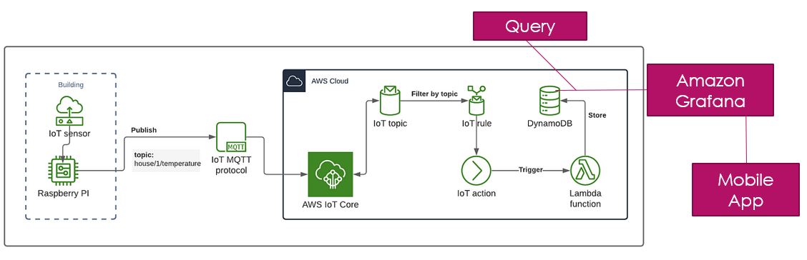
Architecture Design - Brief

Slide 5
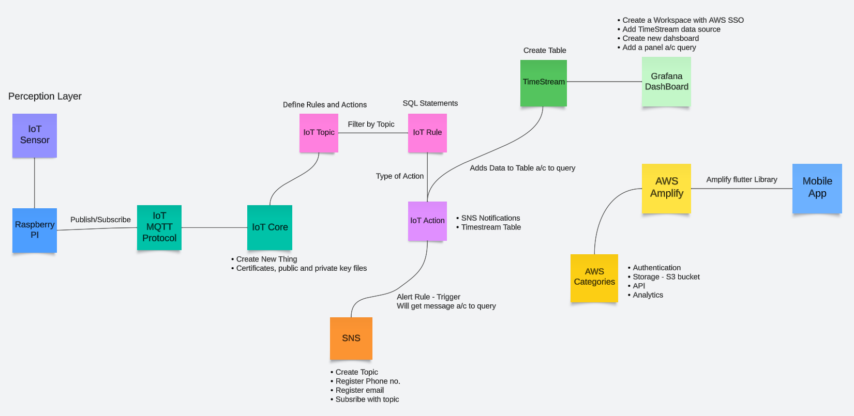
Architecture Design

Slide 6
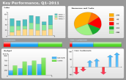

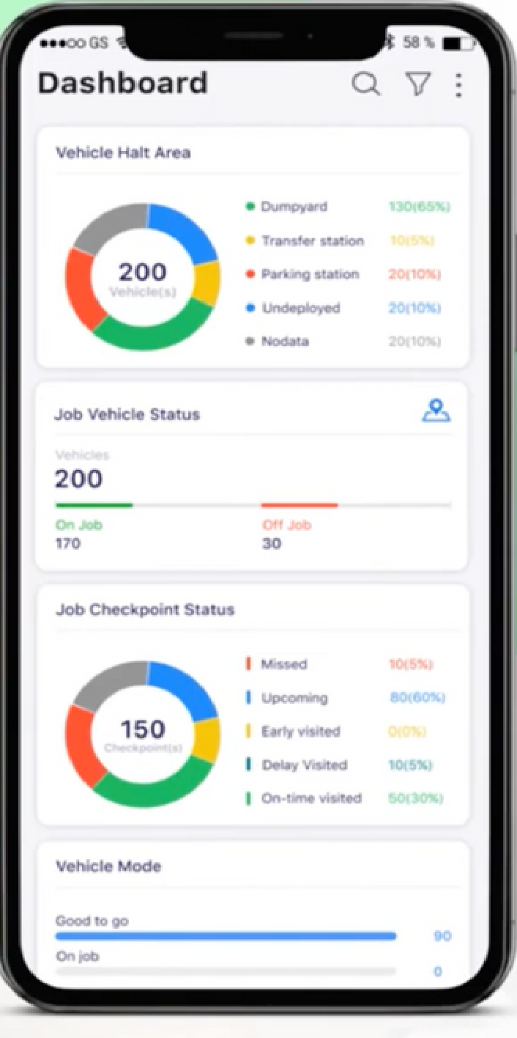
Application design
details
Amazon Web Services
Adds Data to Table according to query
Create table
Grafana
Time series
Create a workspace with AWS SSO
Add time stream data source
Create new dashboard
Add a panel according to the query
IoT sensors
Filter by topic
SQL action
Dynamo
DB
MQTT Broker
MQTT Subscriber
IoT rule
IoT topic
Edge device
Rpi + Router
MQTT
Publish topic
AWS IoT Core
Type of action
Store
>
λ
Lambda
function
IoT action
Trigger
Laptop
Create New Thing
Public and Private key files
SNS Notifications
Timestream table
SNS
Flutter
Library
REST
SMS or email alert
AWS
Categories
AWS
Amplify
Alert rule + Trigger
Will put message according to query
Authentication
Storage + S3 bucket
APIs
Analytics
Remote mobile device

Slide 7
Steps to connect AWS with laptop
Create a AWS account.
Register the IoT device on AWS IoT Core (New thing)
Create a certificate and download certificates, key files.
Create a new policy with required actions and link it with certificate.
Create a NodeJS program that will send data to the AWS IoT server using the MQTT protocol.
You will see messages popping up on your terminal as well as AWS console via MQTT.

Slide 8
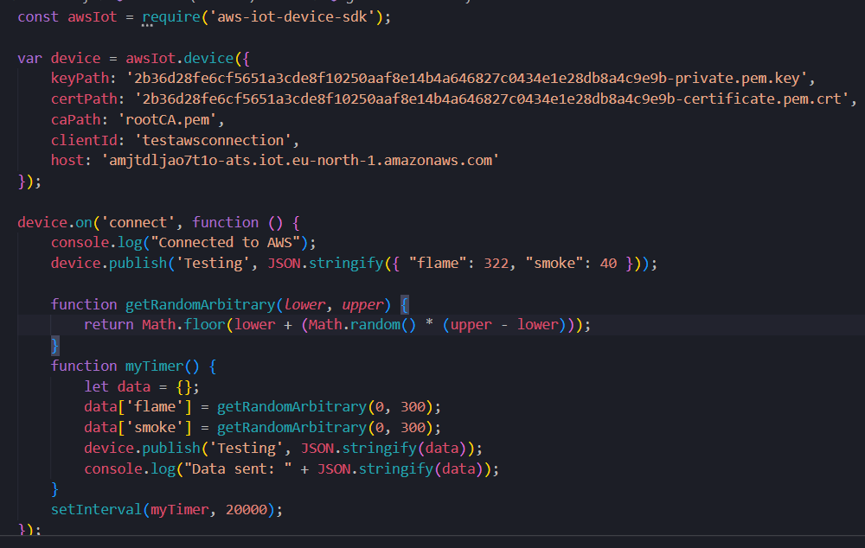
NodeJS Script

Slide 9
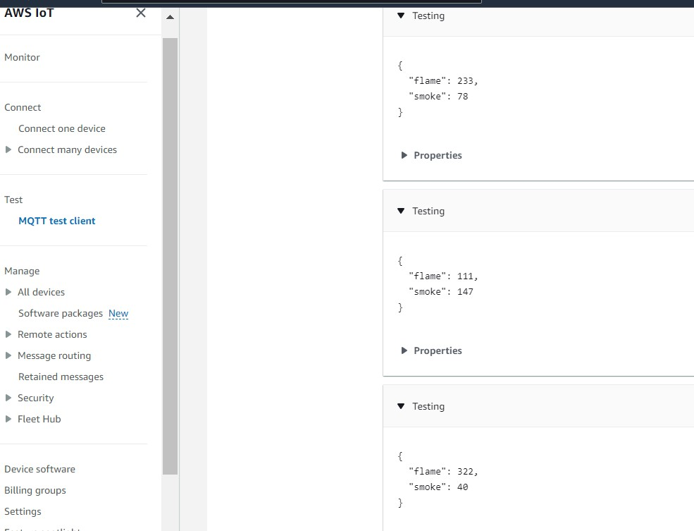
Received Messages on AWS

Slide 10
Steps to send Alert messages
Go to Rules section in AWS IoT.
Create a new rule with respective SQL query.
Add action as SNS push Notification.
Now go to SNS, create a topic.
Register your phone no./email and create a new subscription with same topic.
Now when this alert rule is active, we will get the message according to query.

Slide 11
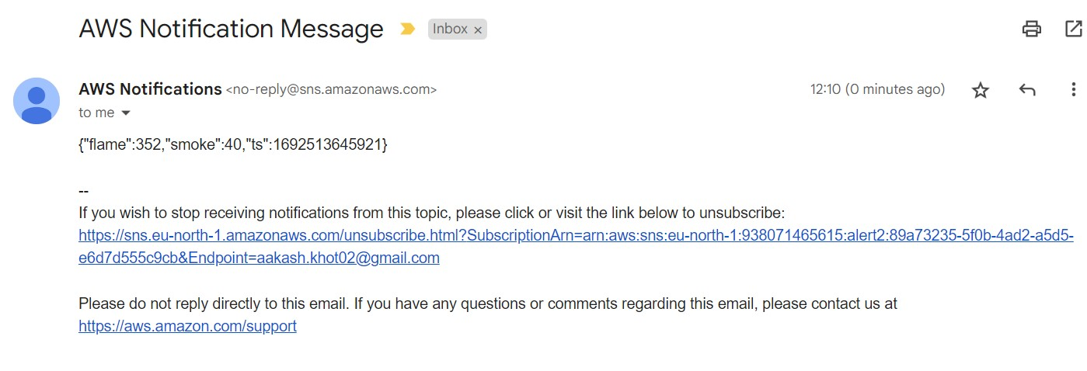

Mail & SMS Alert

Slide 12
Visualizing On Amazon Grafana Dashboard
Select Amazon Managed Grafana and create a workspace with AWS SSO (Single-Sign ON) enabled
Create a user and group and make user as admin.
Login to AWS from the Grafana workspace URL.
Choose device endpoint and select the database and also select the measure which is needed to be visualized.
Add a new panel and according to SQL query.

Slide 13
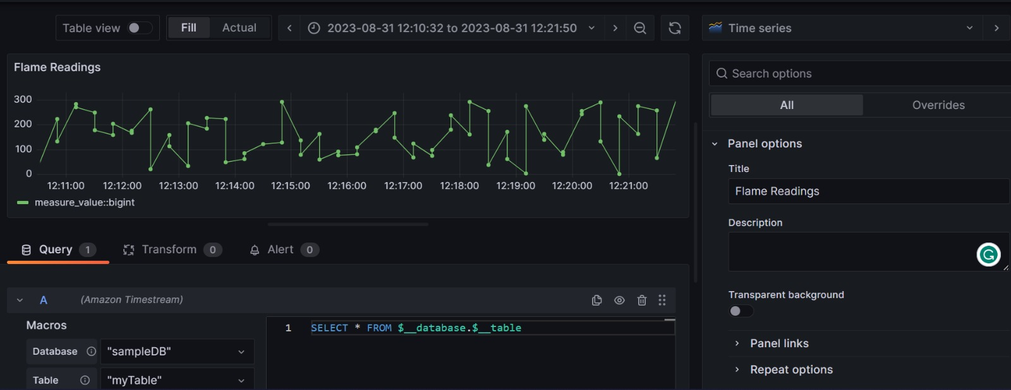
Amazon Grafana - Flame w.r.t Time

Slide 14
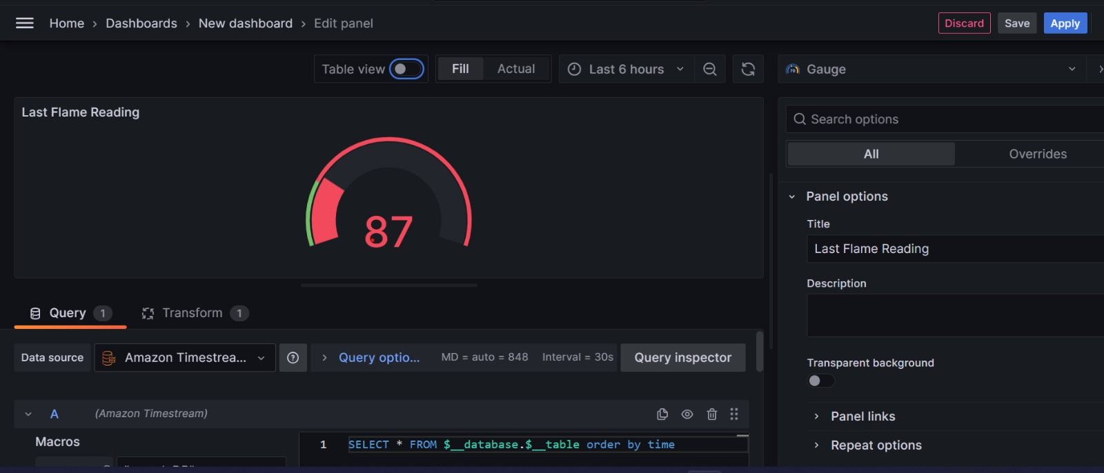
Amazon Grafana - Latest Flame Reading

Slide 15
AWS Amplify with Flutter
Requirements - Latest versions of Node.js, npm, git, and flutter.
Install Amplify CLI - The Amplify Command Line Interface (CLI) is a unified toolchain to create AWS cloud services for your app.
Configure amplify - with new user giving access to amplify.
Create a flutter project and add Amplify to the new project created - changing dependencies. (Note - use sudo for every command)
Setup a platform of your choice - Android, web etc which requires some extra setup and changes to the env.
Amplify init - To initialize the project and deploy the backend on aws.

Slide 16
Processing Data using Lambda Function
AWS lambda Function :- Process and transform the data from your IoT device before sending it to your Flutter app. (mqtt)
IoT rule to trigger the function when message arrives.
To send this data to flutter app, have another Lambda function make an HTTP POST request to an API endpoint. (AWS service like API Gateway).
Basically, set up an API Gateway in AWS to act as an HTTP endpoint. You can configure API Gateway to trigger a Lambda function when an HTTP request is received.

Slide 17
Flutter App Integration
HTTP or WebSocket Connection - Use either the http package for HTTP communication or a WebSocket library.
Use the http package in Flutter to make an HTTP GET or POST request to the AWS Lambda function's endpoint or API Gateway URL.
When your Flutter app sends an HTTP request, AWS Lambda can respond with the processed data.

Slide 18
API Gateway Setup
Go to the AWS API Gateway console and create a new API.
Create a resource and define an HTTP POST method for that resource.
Configure the method integration to invoke the Lambda function.
Deploy the API to make it accessible over the internet. AWS will provide you with an endpoint URL.

Slide 19
Dashboard
Able to make a react app and hosted it on AWS Amplify.
Utilized AWS Amplify and AppSync to seamlessly integrate GraphQL into our app, enabling efficient and flexible data querying.
Enhanced security by integrating AWS Amplify's authentication features, including services like Amazon Cognito, for easy implementation of secure user sign-in and access control.
Now made a React-Dashboard for visualizing the data - https://github.com/aakash2khot/React-Dashboard

Slide 20
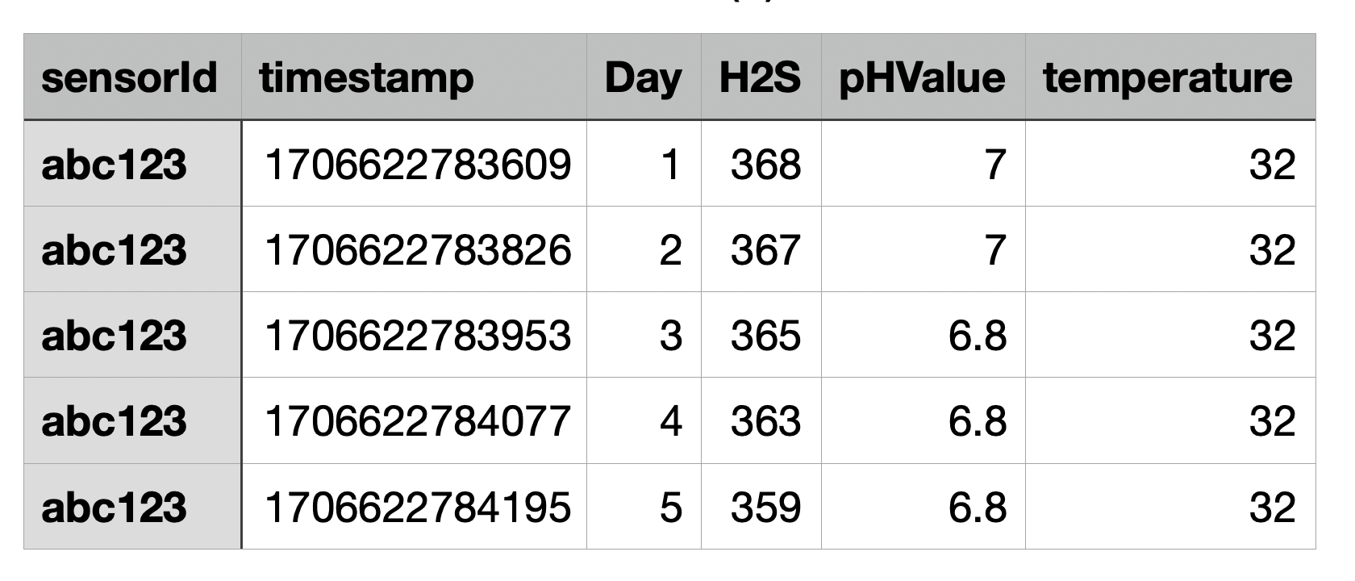
References for Connection b/w DynamoDB & Node.js
https://www.youtube.com/watch?v=SU4dZ-qgR1Y&t=428s&ab_channel=CodeSpace
https://dev.to/aws-builders/dynamodb-using-aws-sdk-for-javascriptnodejs-43j1
Sample Table

Slide 21
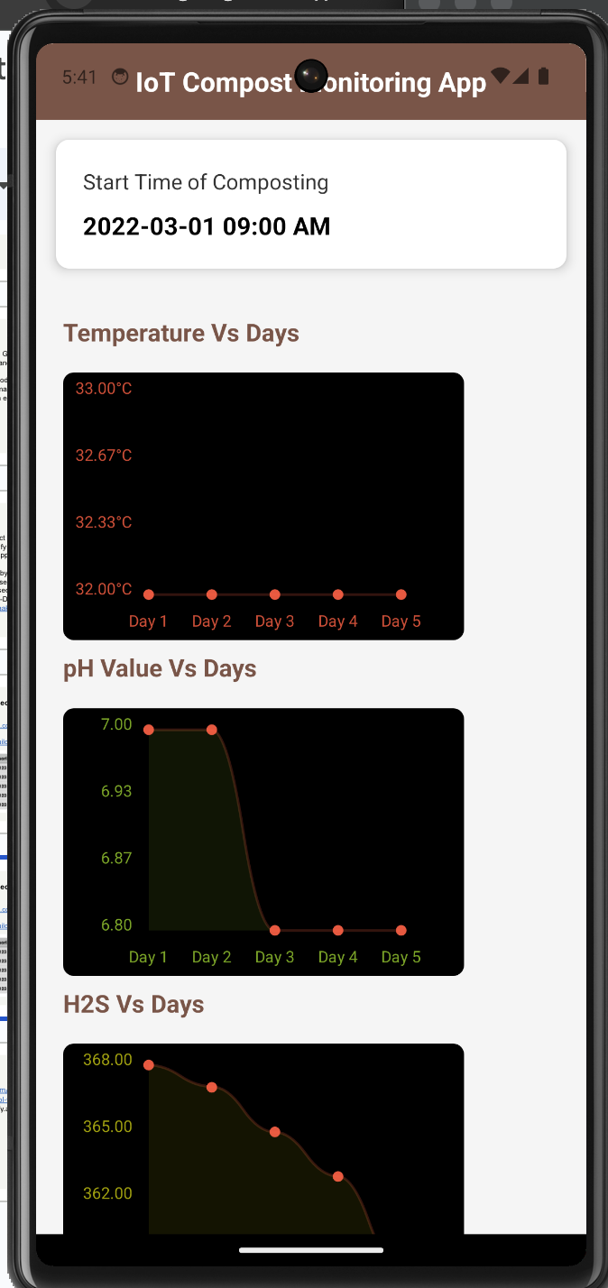
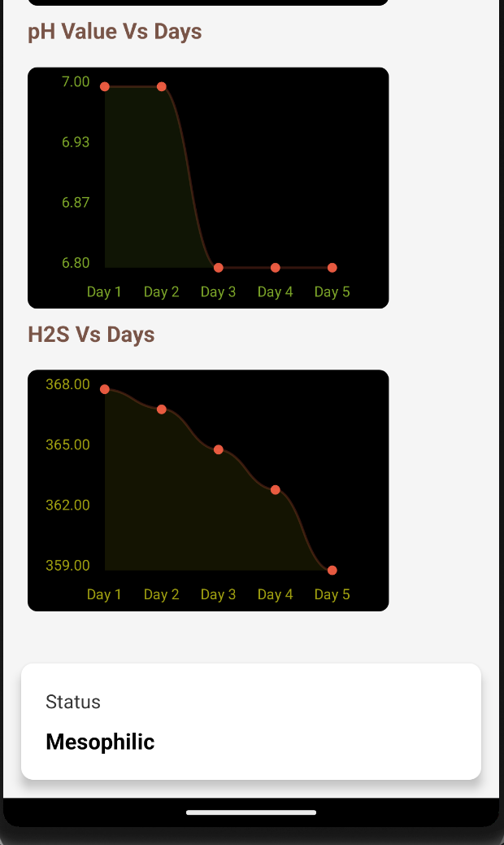
Demo App – React Native
and Node.js
Taking data from Dynamo
DB using Node.js (backend)
- React Native used for Front- end

Slide 22
References for React Native Android apps
https://www.youtube.com/watch?v=xKGESzemfdw&ab_channel=Codevolution
https://stackoverflow.com/questions/33704130/react-native-android-fetch-failing-on-connection-to-local-api
Github Link for the Project Code:- https://github.com/aakash2khot/IoT-Compost-Monitoring-App.git

Slide 23
References
https://medium.com/dev-jam/getting-started-with-aws-iot-core-and-mqtt-protocol-with-a-node-js-example-ed16bd542704
https://docs.amplify.aws/start/getting-started/integrate/q/integration/flutter/

Slide 24
Thanks

Slide 25




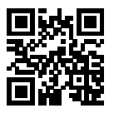



International Institute of Information Technology Bangalore
26/C, Electronics City, Hosur Road,
Bengaluru – 560 100, Karnataka, India
www.iiitb.ac.in
https://www.facebook.com/IIITBofficial/
https://twitter.com/IIITB_official
https://www.linkedin.com/school/iiit-bangalore/
https://www.youtube.com/user/iiitbmedia
https://www.instagram.com/iiitb_official/

